Slide 1
Sushi – An exquisite recipe for NGS data analysis
Supporting User for SHell-script Integration
Hubert Rehrauer & Masaomi Hatakeyama

Slide 2
What is your data analysis wishlist?
We had in mind:
analyze by clicking
scriptable
manage my meta-information
document all analysis steps
organize my work
I can add analysis applications
connects to my compute resources
keep everything in files on my disk
no painful file formats
The bioinformatician stays in the driver seat

Slide 3
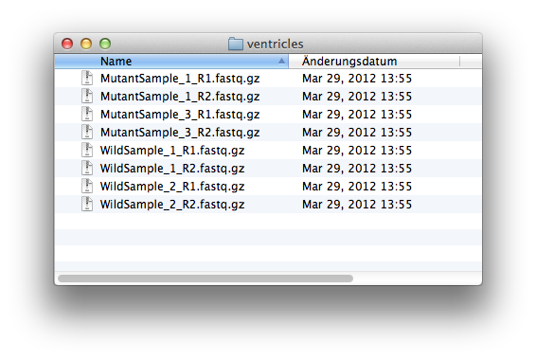
The Sushi idea (I)
Start with a bunch of raw data files on your disk:

Slide 4
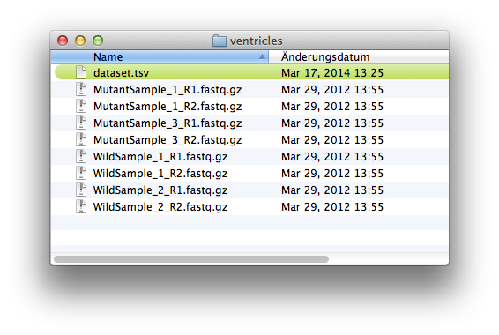
The Sushi idea (II)
Add the magic seasoning: Meta information

Slide 5
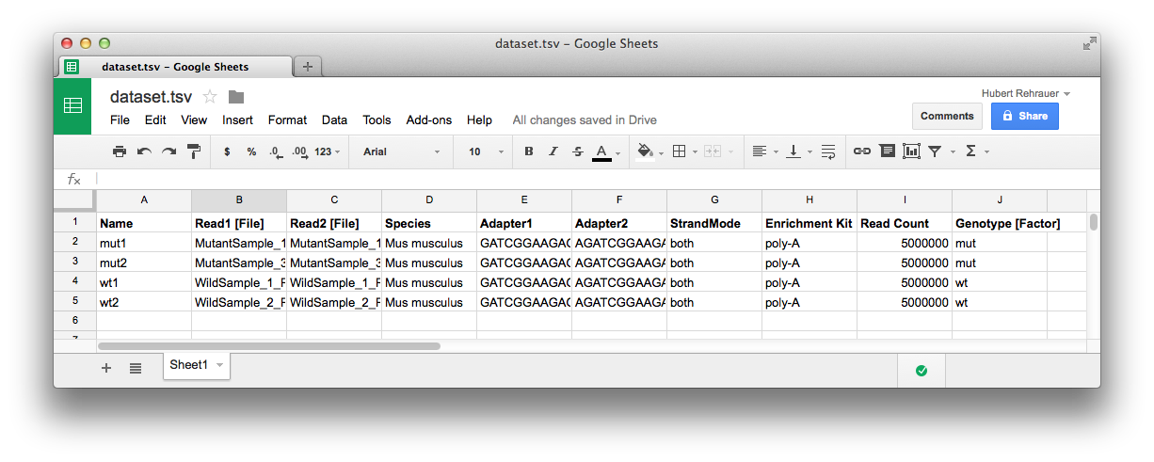
Meta-information turns mere data files into a data set
One row per sample
associated files
everything else noteworthy about the files and the samples

Slide 6
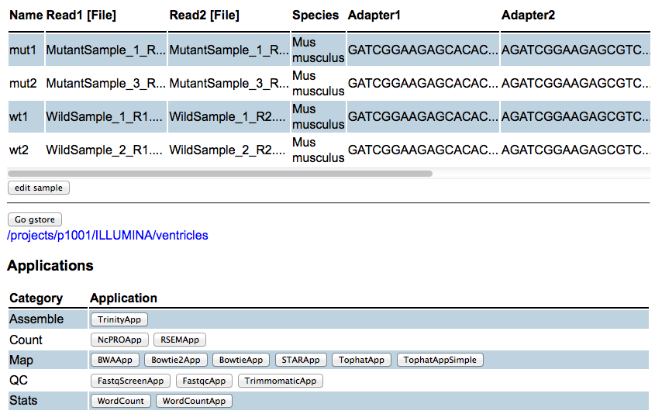
Sushi offers a choice of analysis apps for your data set
The meta-information columns drive the available applications

Slide 7
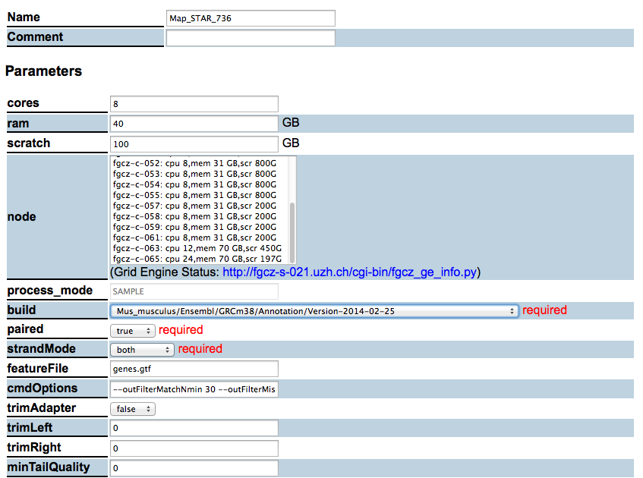
Sushi lets you control all parameters
as selectors
or
as free text

Slide 8
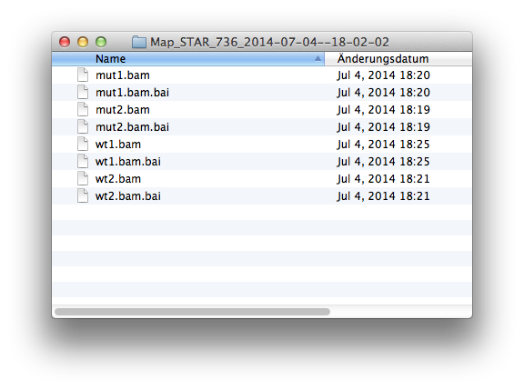
The processing jobs generate the data files …

Slide 9
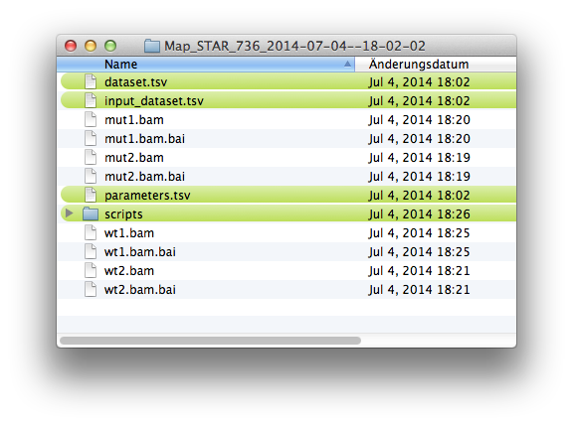
Sushi adds all ingredients to make them a new, documented data set …

Slide 10
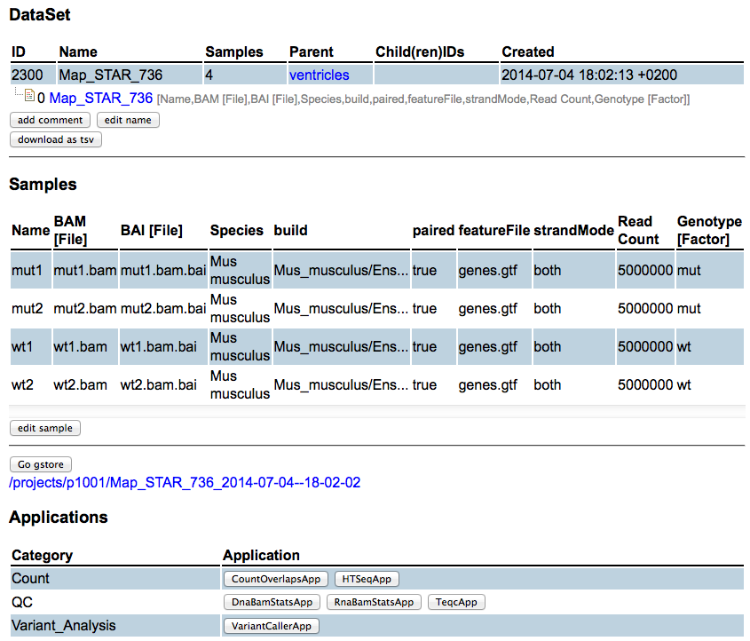
… and Sushi let’s you move to the next analysis

Slide 11
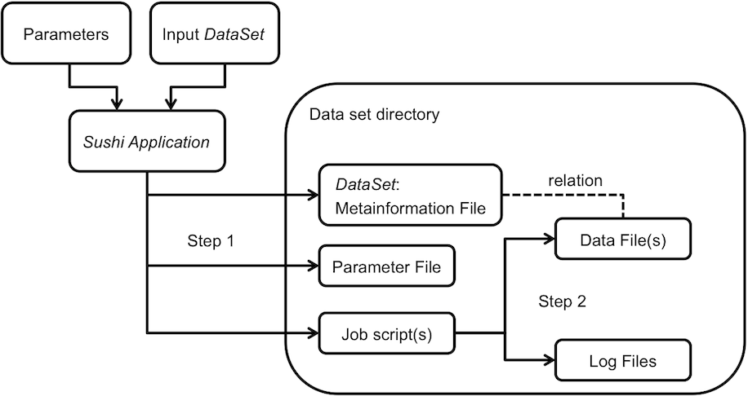
The Sushi Data Analysis Process
Step 1
Generate Job script(s)
Step 2
Submit the Job script(s)
Notes:
add input files !!!

Slide 12
Sushi Modules
Sushi UI
Ruby on Rails
GUI
Sushi Application
Single Ruby file
CLI
Workflow Manager
Ruby gem library
Job Control

Slide 13
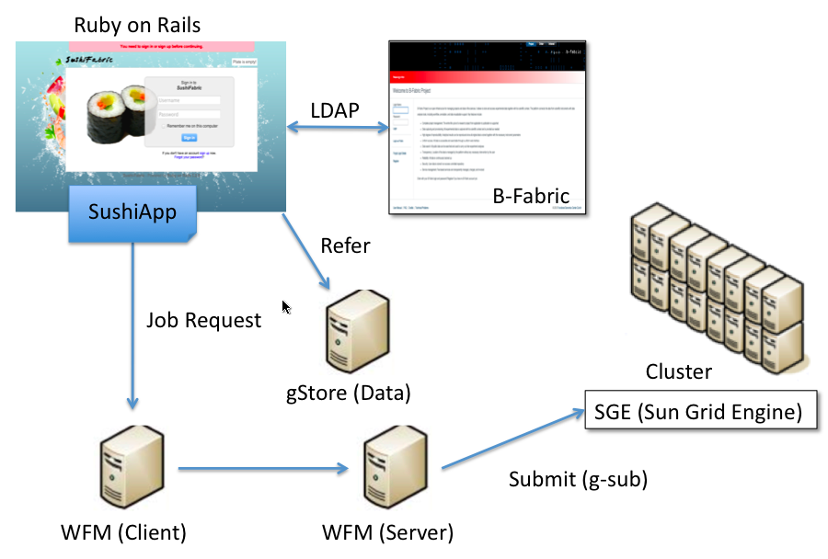
Sushi Components at FGCZ

Slide 14
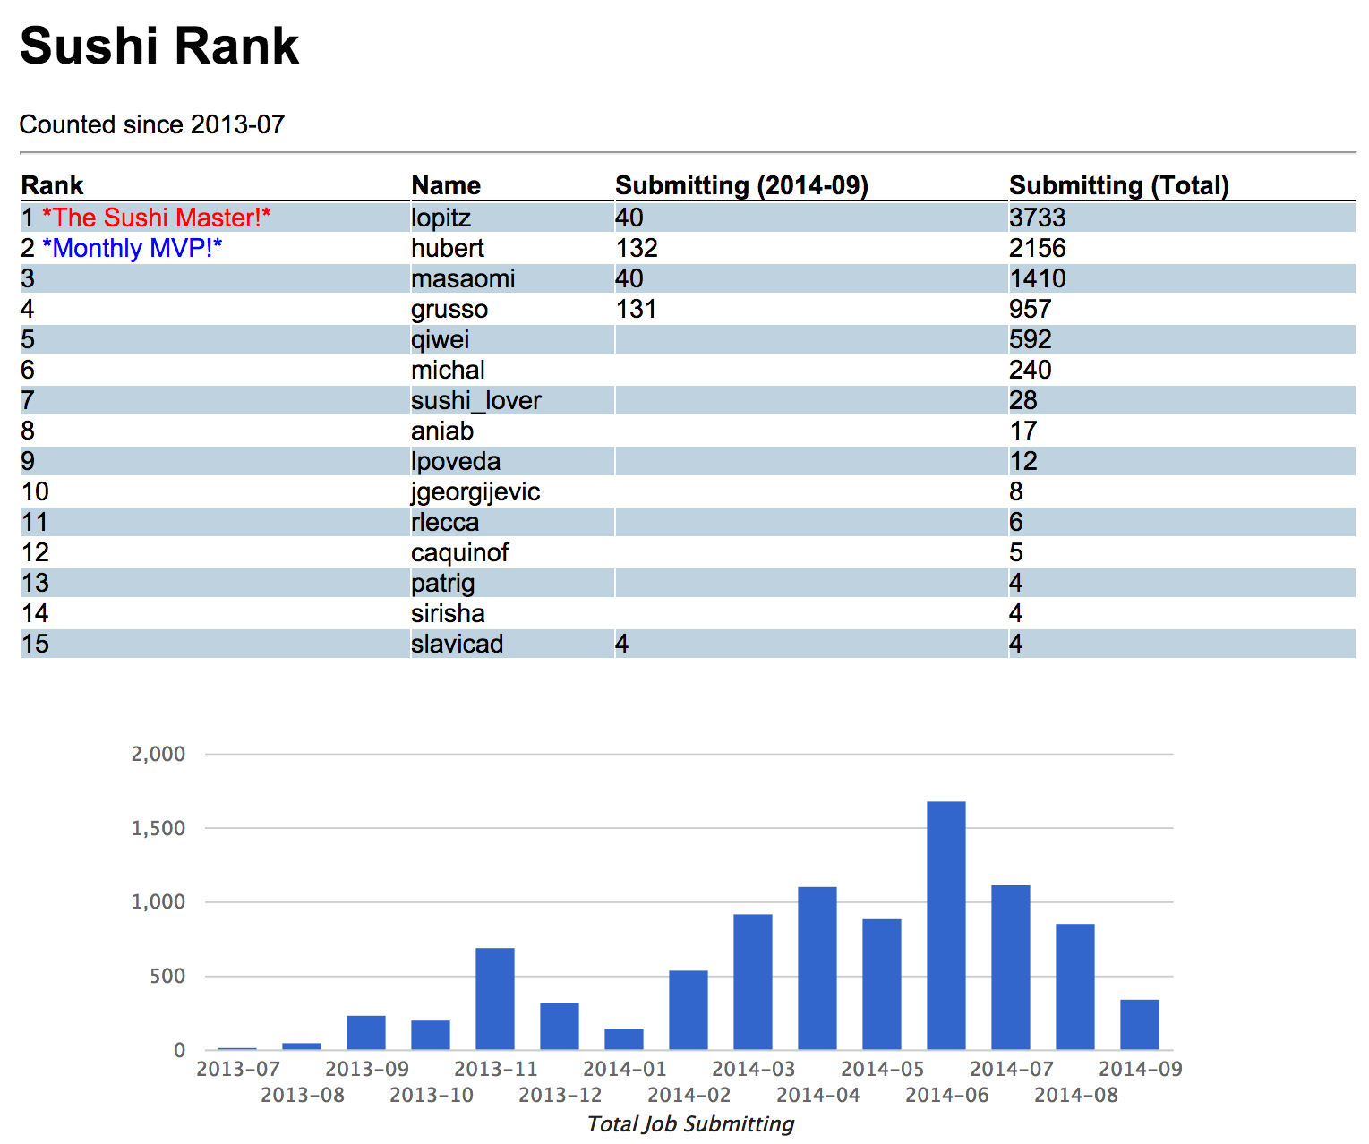
Sushi Rank

Slide 15
Why choose Sushi?
It has never been easier to import meta-information
It has never been easier to add new data analysis applications
Sushi does not impose constraints on your data analysis → Your applications define the semantics
You never have to export your data again → it’s already exported!
You never have to document your analysis again → the result is fully self-contained and documented by the time the analysis is done
Sushi keeps your work organized even if you work on 10 different projects with thousands of samples

Slide 16
Acknowledgements
FGCZ Genome Informatics Team
Giancarlo Russo
Lennart Opitz
Weihong Qi
Slavica Dimitrieva

Slide 17
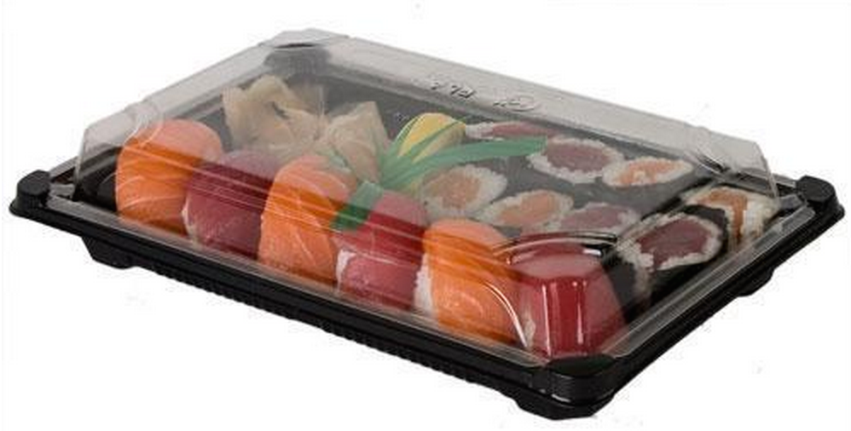
Sushi Takeaways
S
U
S
H
I
SUSHI
Super Easy Pipeline System
Ultra Fast Development
Surprisingly Flexible Ruby code
Highly Independent Modules
Intermediary between biologist and informatician

Slide 19
Sushi Demo 10 minutes
Installation 1 min
Data import/Job submission 2 mins
New application import 3 mins
Case Study 4 mins
RNAseq DEG analysis
Notes:
I would like to demonstrate how to cook NGS raw data on Sushi

Slide 20
Demo Environment
Mac OS X 10.9.4
Ruby 1.9.3
Ruby on Rails 3.2.9

Slide 21
Installation
Downloading Ruby on Rails package
http://fgcz-sushi.uzh.ch/sushi_20140908.tgz
Install libraries
bundle install
Setup DB
bundle exec rake db:migrate
Notes:
Kyoto cabinet

Slide 22
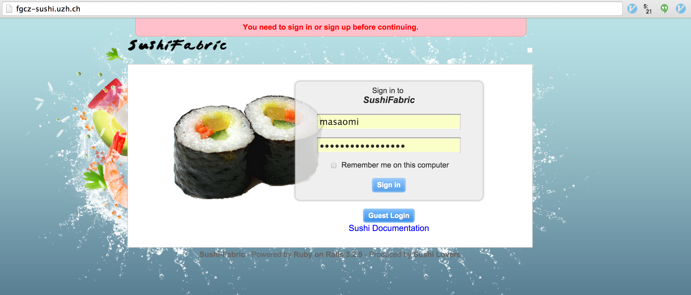
Documents
fgcz-sushi.uzh.ch

Slide 23
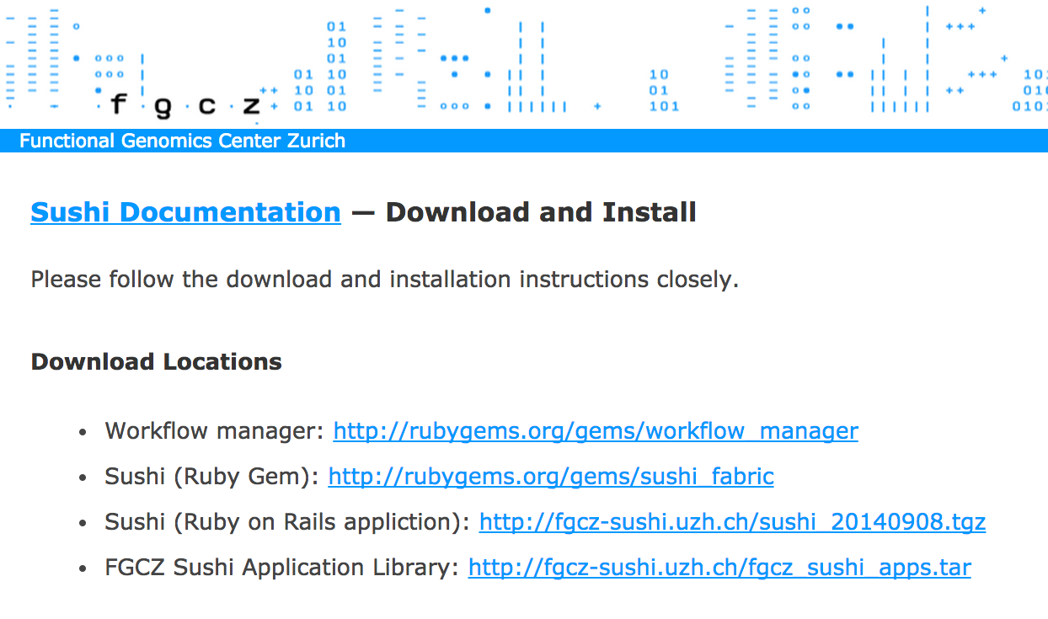
Download
fgcz-sushi.uzh.ch/download.html

Slide 24
Installation Download, Extraction, Library installation, DB setup
$ wget http://fgcz-sushi.uzh.ch/sushi_20140908.tgz
$ tar zxvf sushi_20140908.tgz
$ cd sushi
$ bundle install
$ bundle exec rake db:migrate

Slide 25
Sushi run, workflow_manager run
$ rails server
$ workflow_manager

Slide 26
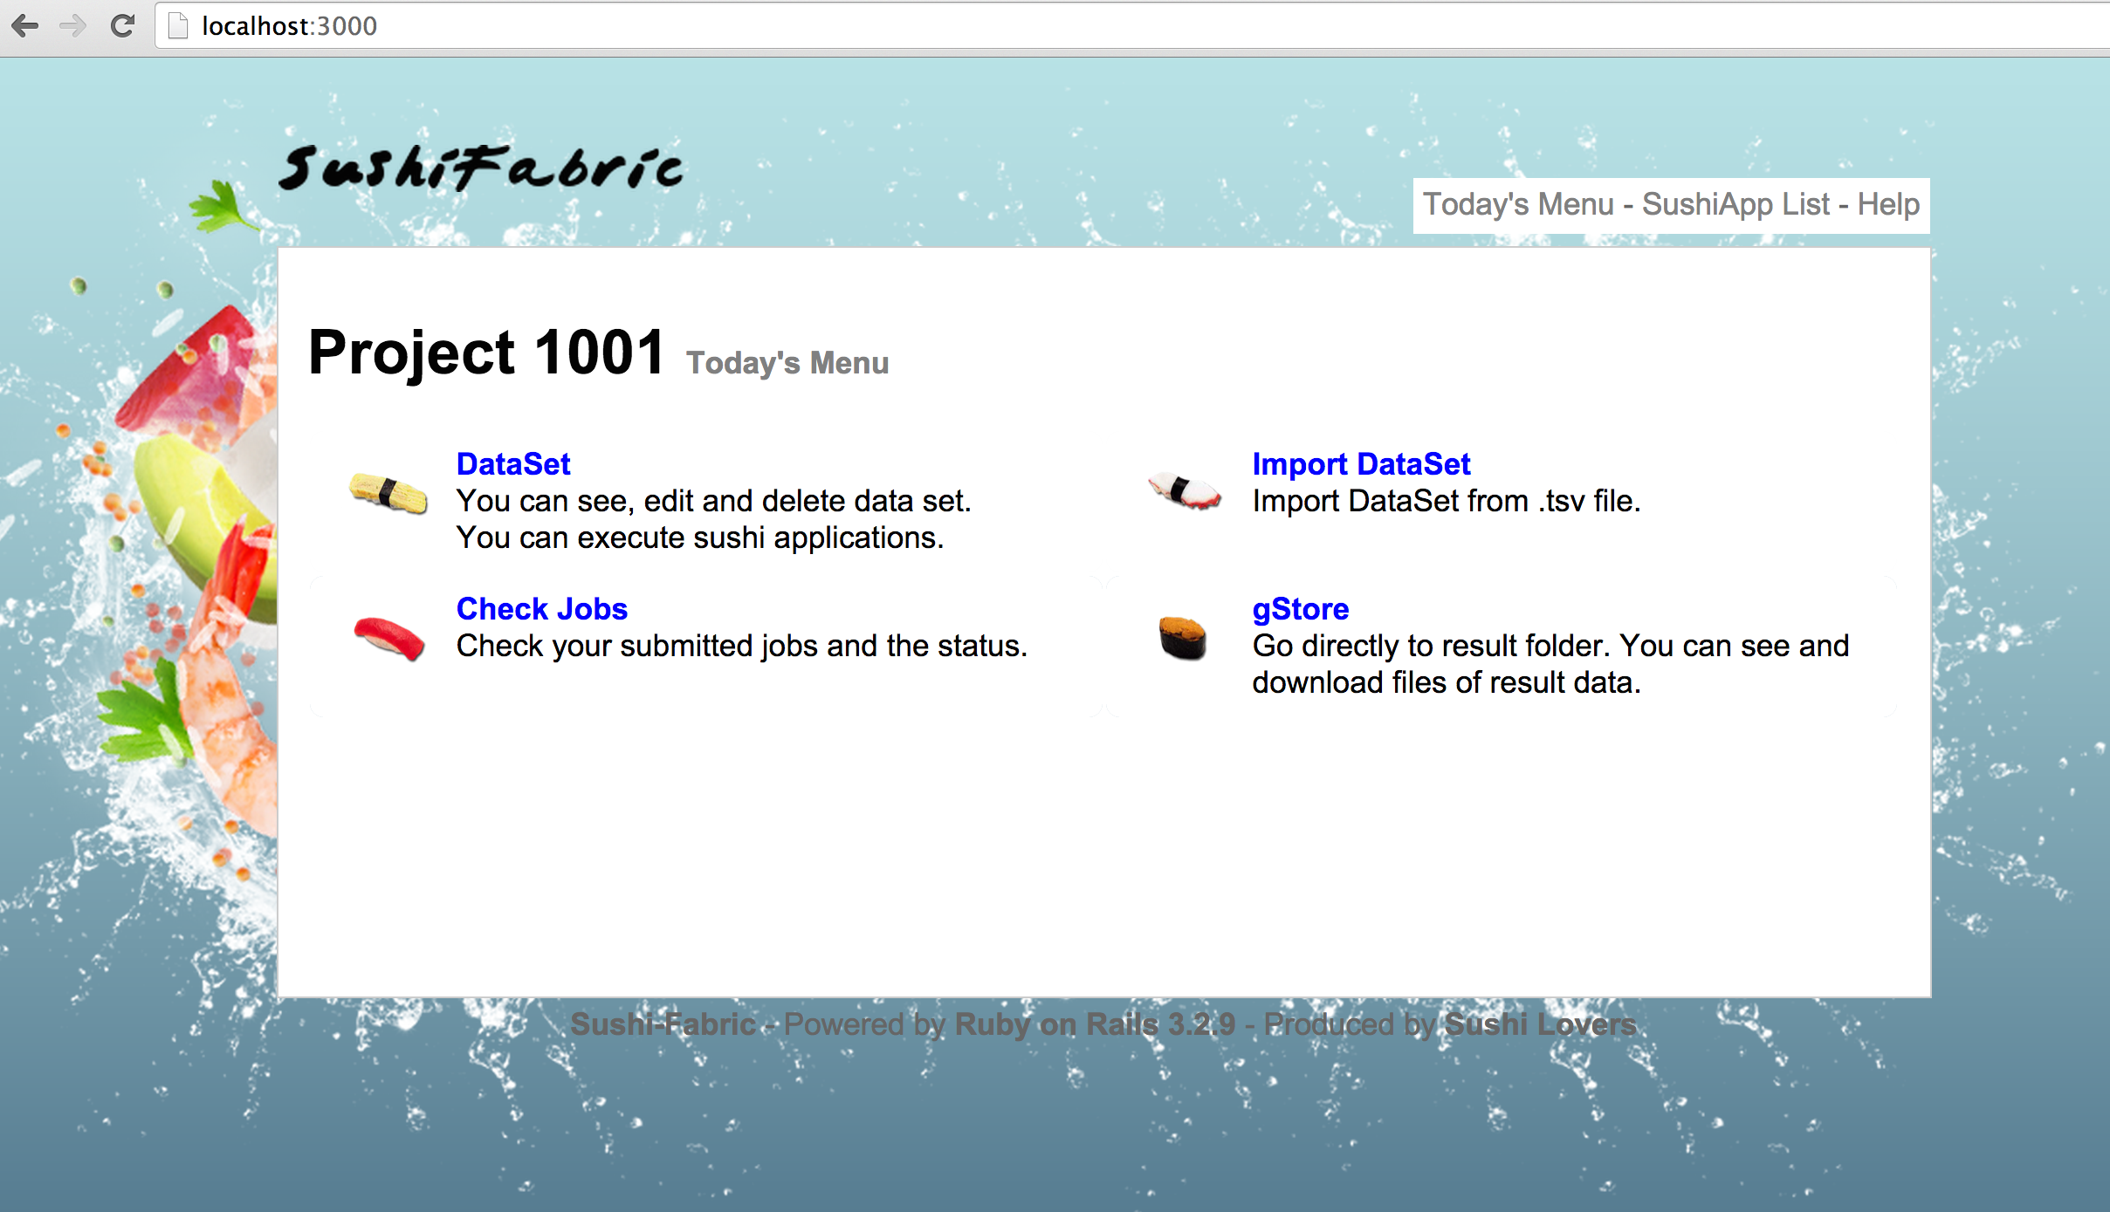
Sushi Access
localhost:3000

Slide 27
Data import / Job submission
Prepare your data set
Import dataset.tsv
Check samples
Select an application
WordCountApp
Set parameters
Submit a job
Check job status
Check job script/log
public/projects
Check result

Slide 28
DataSet Import

Slide 29
DataSet Import

Slide 30
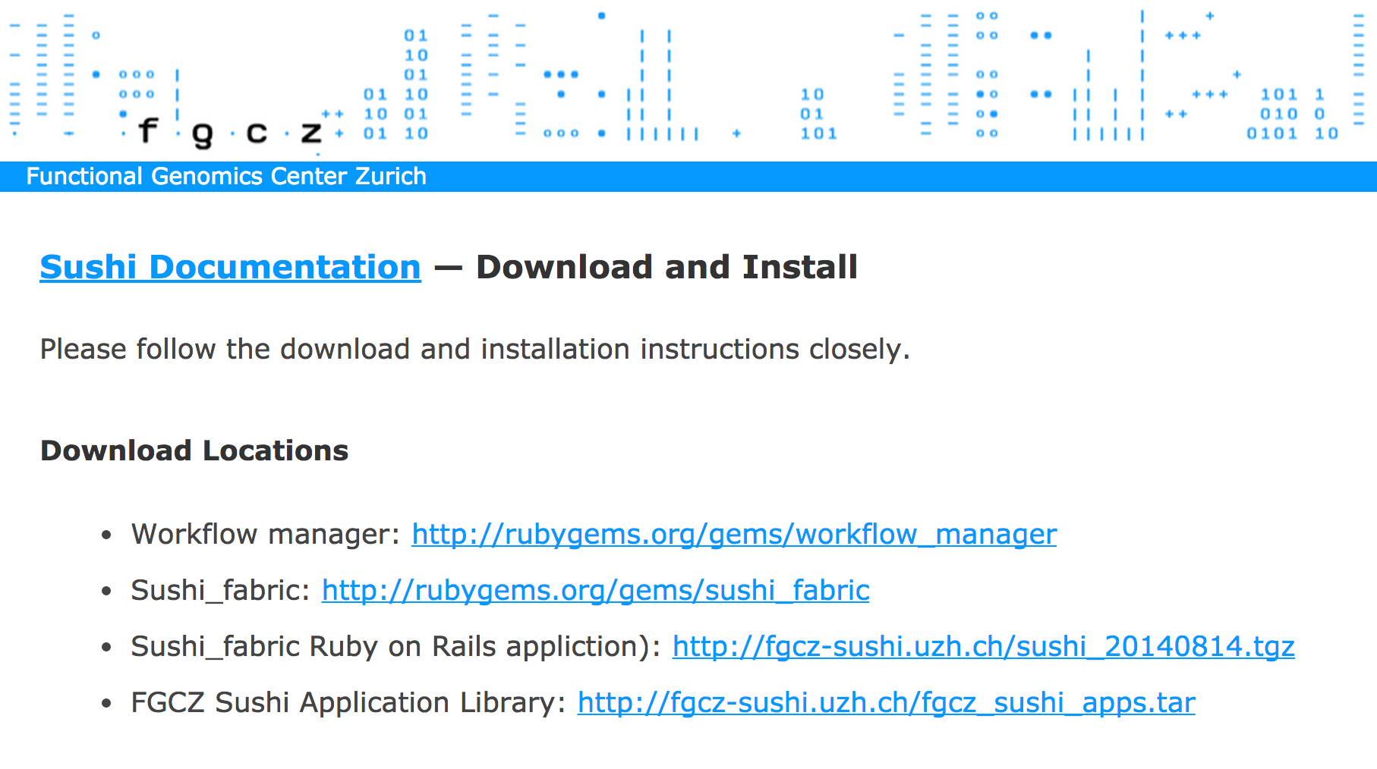
New Application Import
fgcz-sushi.uzh.ch/download.html

Slide 31
New Application Import
$ wget http://fgcz-sushi.uzh.ch/fgcz_sushi_apps.tgz
$ tar xvf fgcz_sushi_apps.tgz
$ cp fgcz_sushi_apps/FastqcApp.rb sushi/lib/
$ cp -r fgcz_sushi_apps/R_scripts sushi/lib/

Slide 32
A Case Study –RNAseq DEG analysis-
RNAseq Analysis
Quality Control
FastQC
Mapping
STAR
Counting
HTSeq
Differential Gene Expression
EdgeR

Slide 33
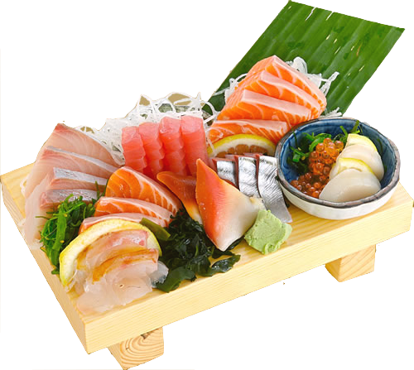
Summary
S
A
S
H
I
M
I
Shell script auto-generating
Application Framework
Support all languages
Help bio-logist/-informatician
Implemented in Ruby
Meta-Information DataSet
Interface: GUI / CLI
Notes:
I would like to demonstrate how to cook NGS raw data on Sushi

Slide 34
Thank you for your attention!!
http://fgcz-sushi.uzh.ch

Slide 36
Data import / Job submission
Prepare your data set
Import dataset.tsv
Check samples
Select an application
WordCountApp
Set parameters
Submit a job
Check job status
Check job script/log
public/projects
Check result

Slide 37
DataSet Import

Slide 38
DataSet Import

Slide 39
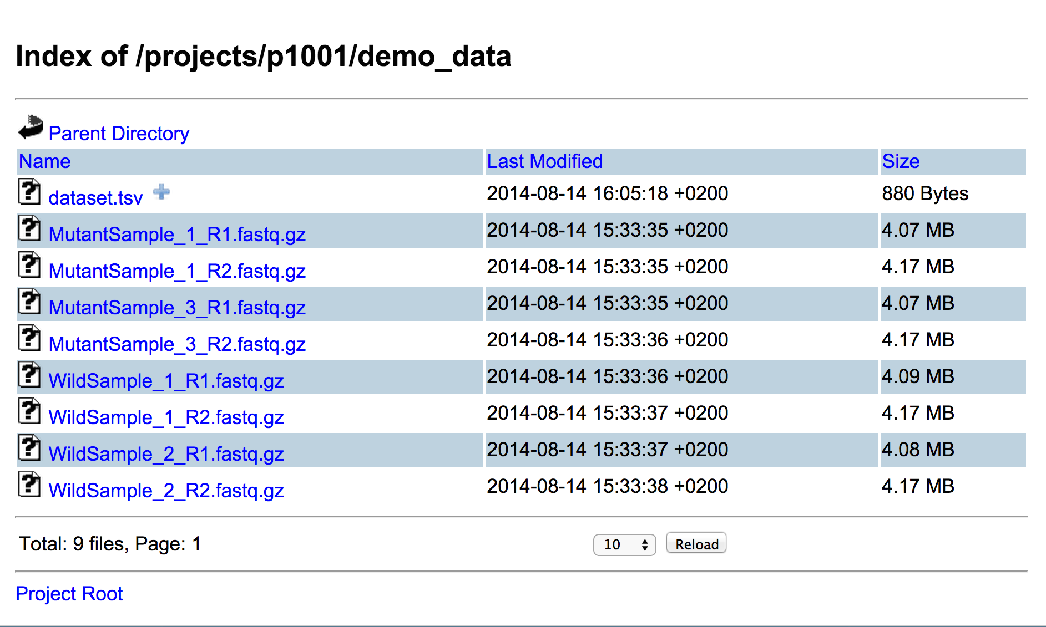
DataSet Import

Slide 40
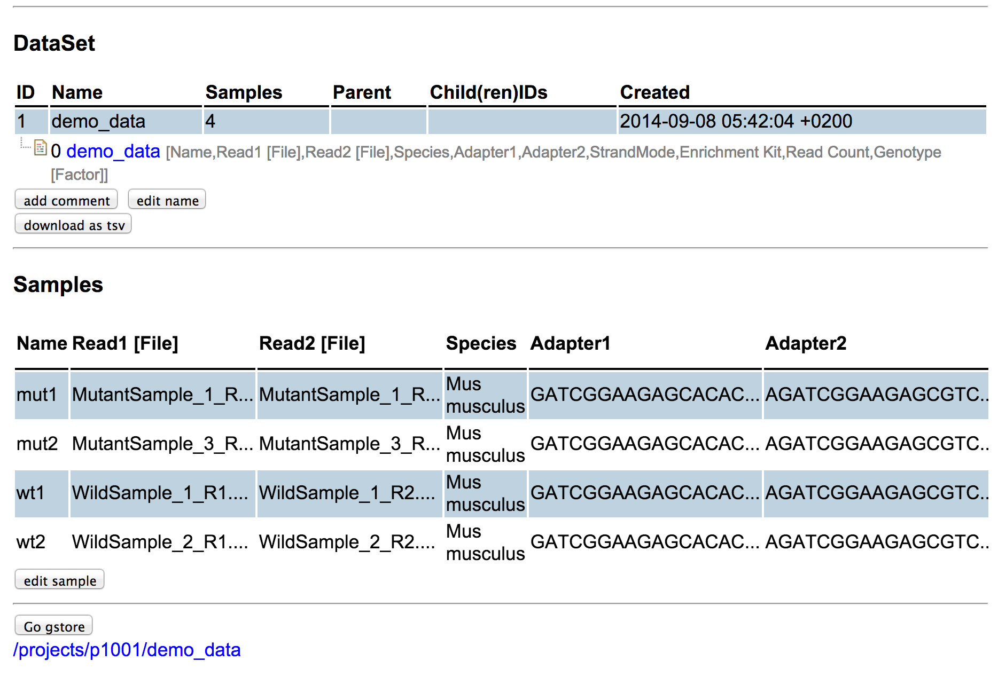
DataSet

Slide 41
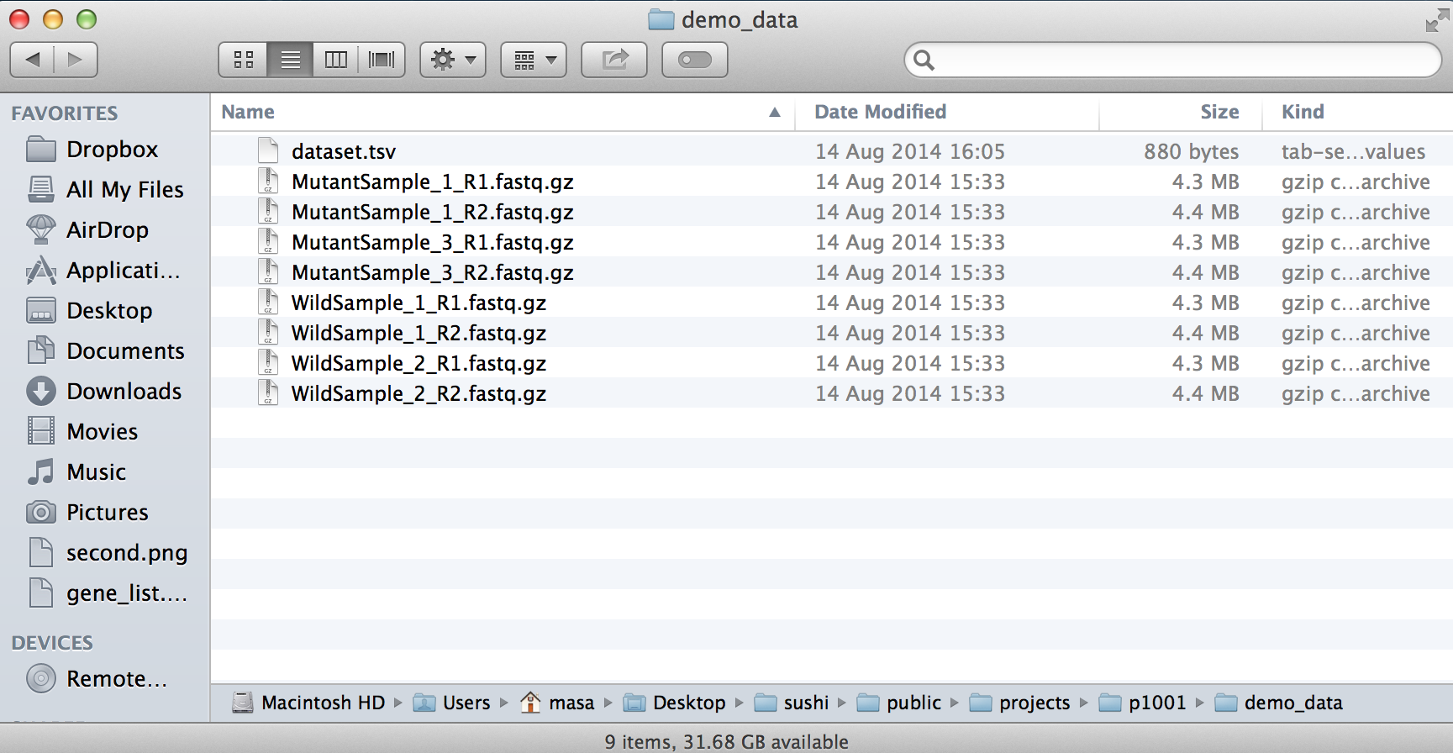
DataSet

Slide 42
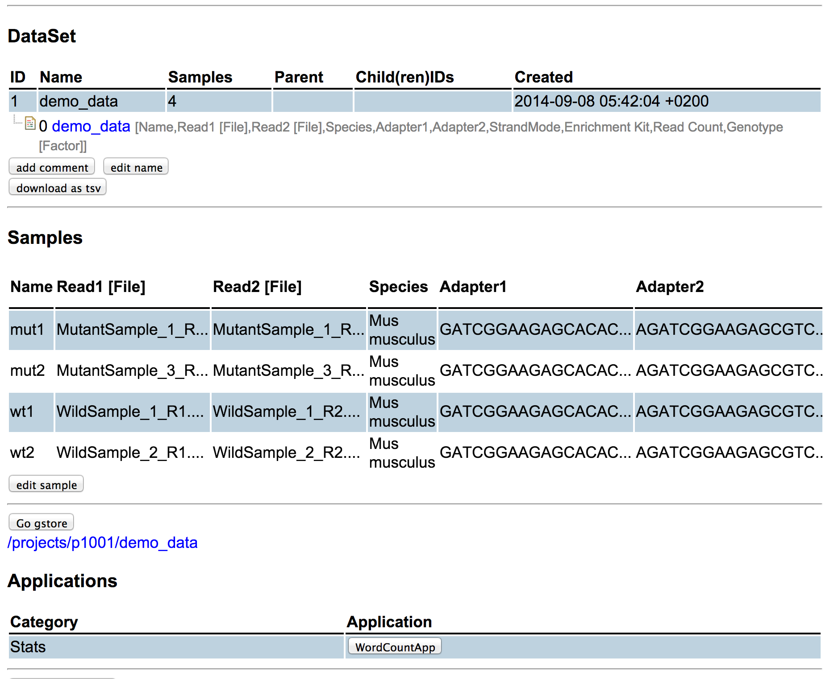
Sushi Application Run

Slide 43
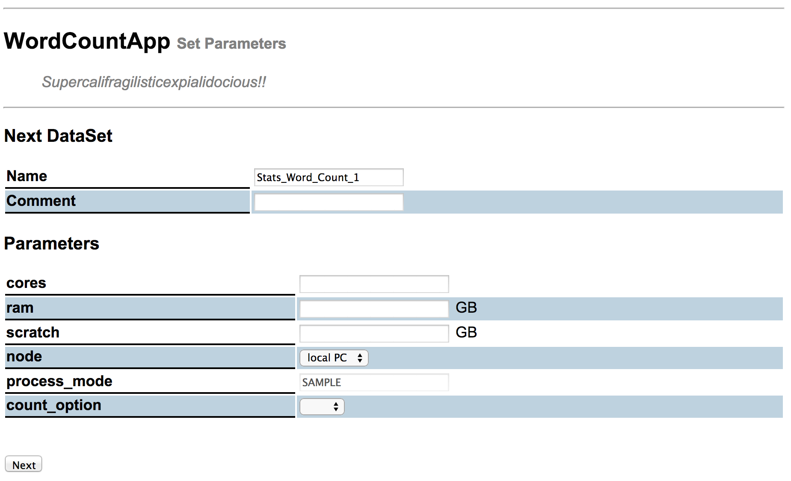
Parameter Setting

Slide 44
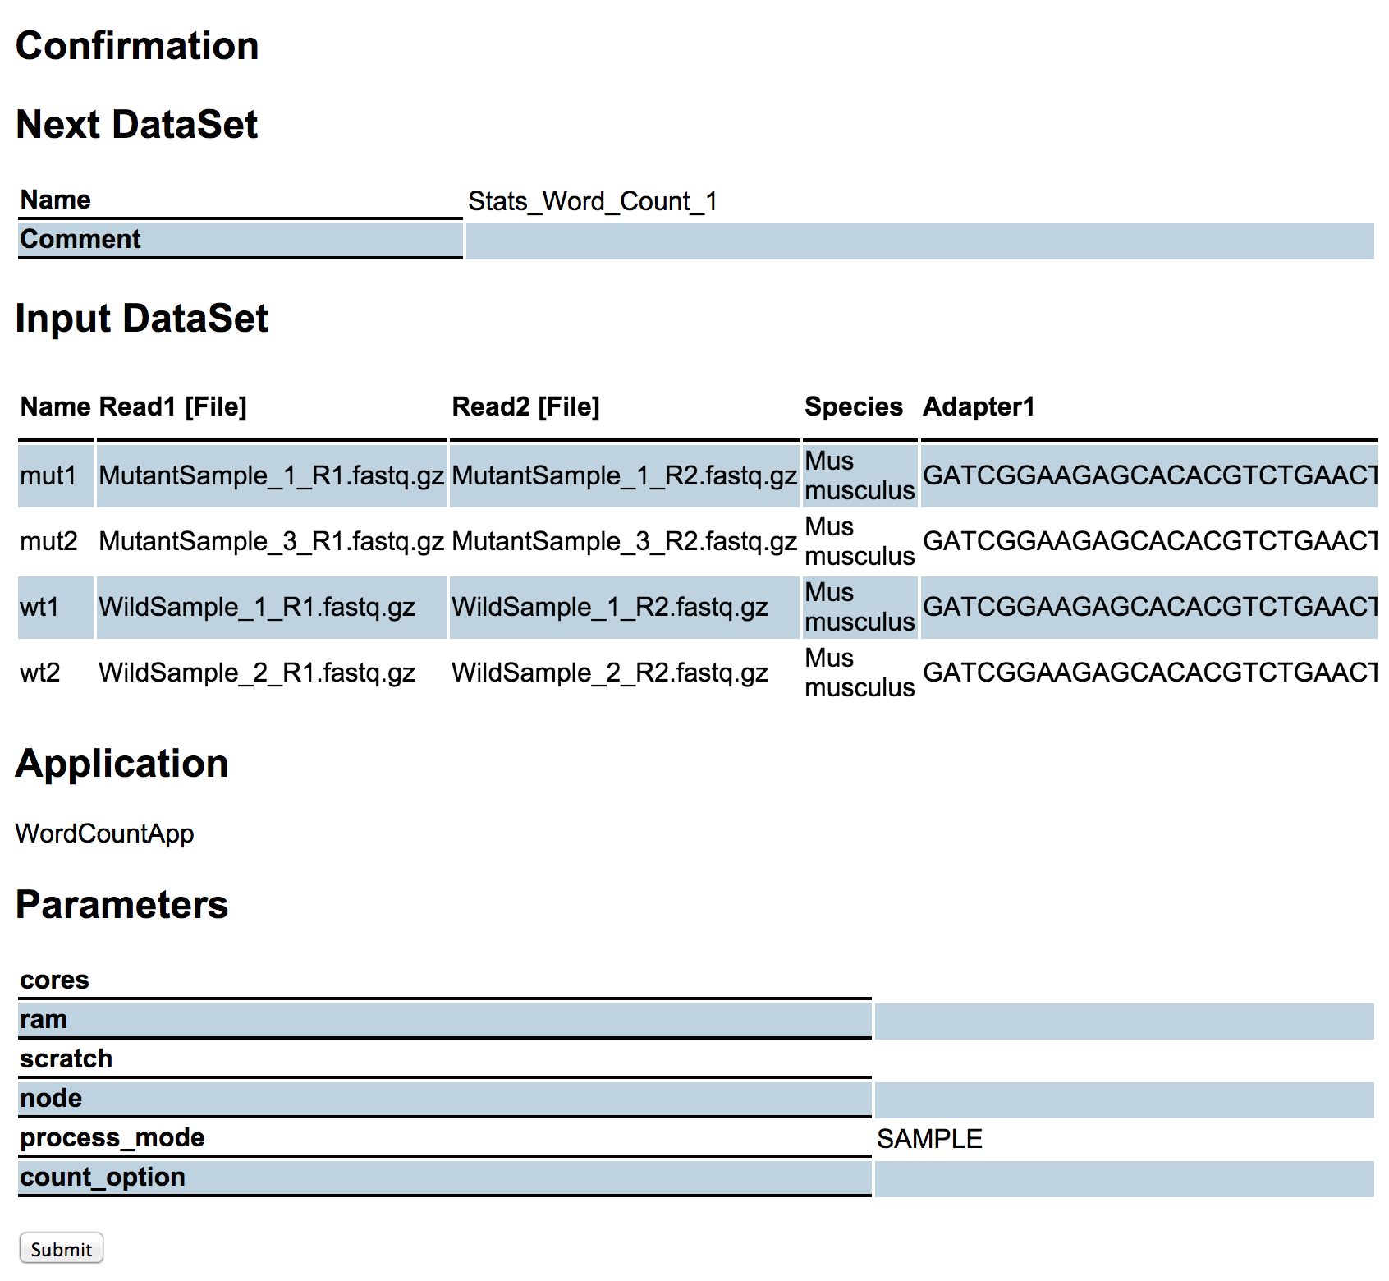
Job Submission

Slide 45
Job Status

Slide 46
New DataSet

Slide 47
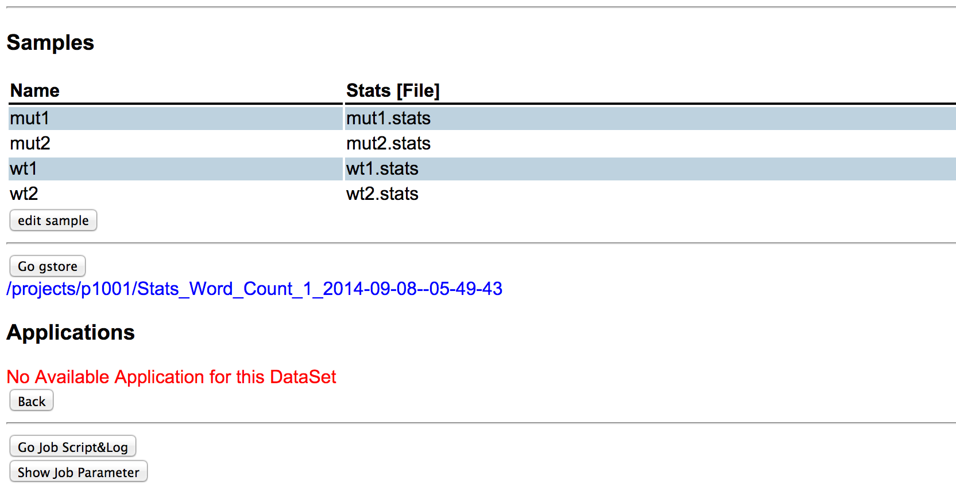
Log, Job Script

Slide 48
Log, Job Script

Slide 49
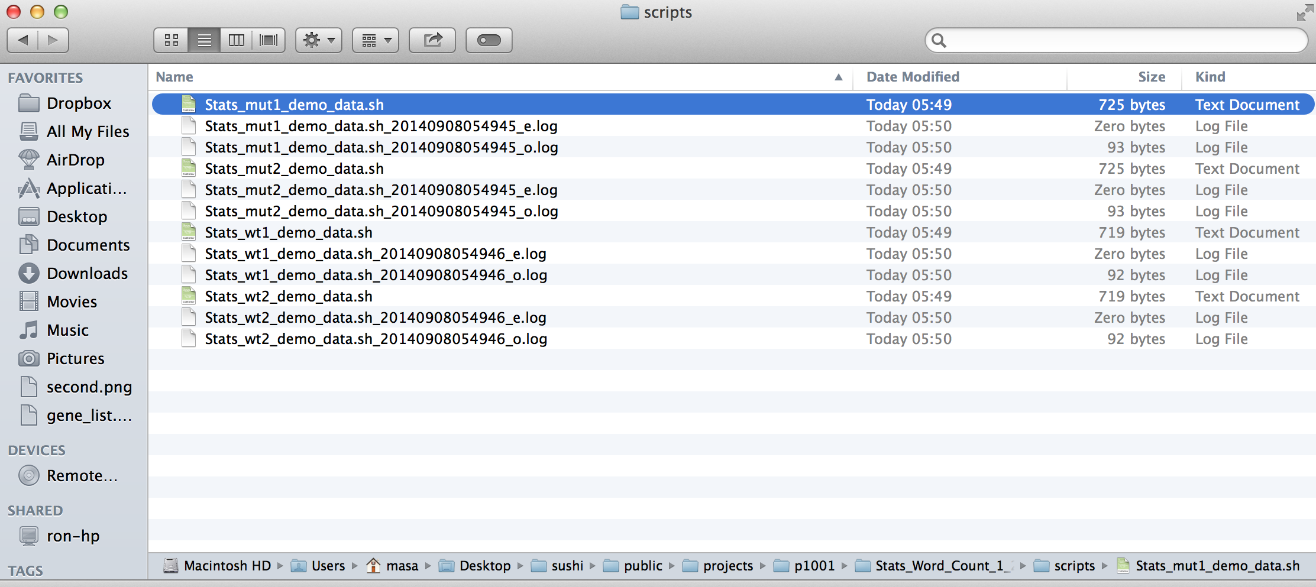
Job Script

Slide 50
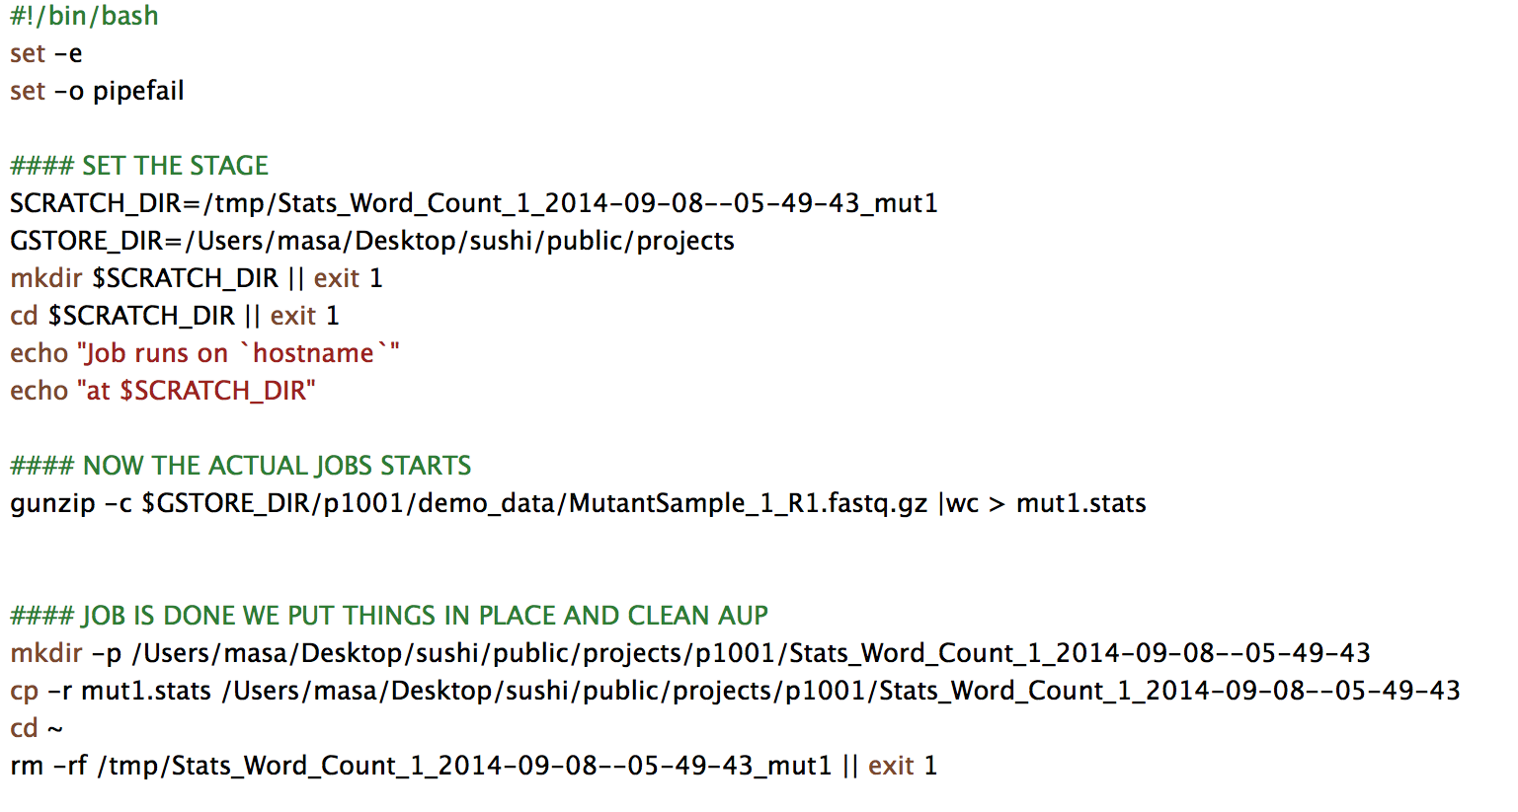
Job Script

Slide 51
New Application Import
fgcz-sushi.uzh.ch/download.html

Slide 52
New Application Import
$ wget http://fgcz-sushi.uzh.ch/fgcz_sushi_apps.tar
$ tar xvf fgcz_sushi_apps.tar
$ cp fgcz_sushi_apps/FastqcApp.rb sushi/lib/
$ cp -r fgcz_sushi_apps/R_scripts sushi/lib/

Slide 53
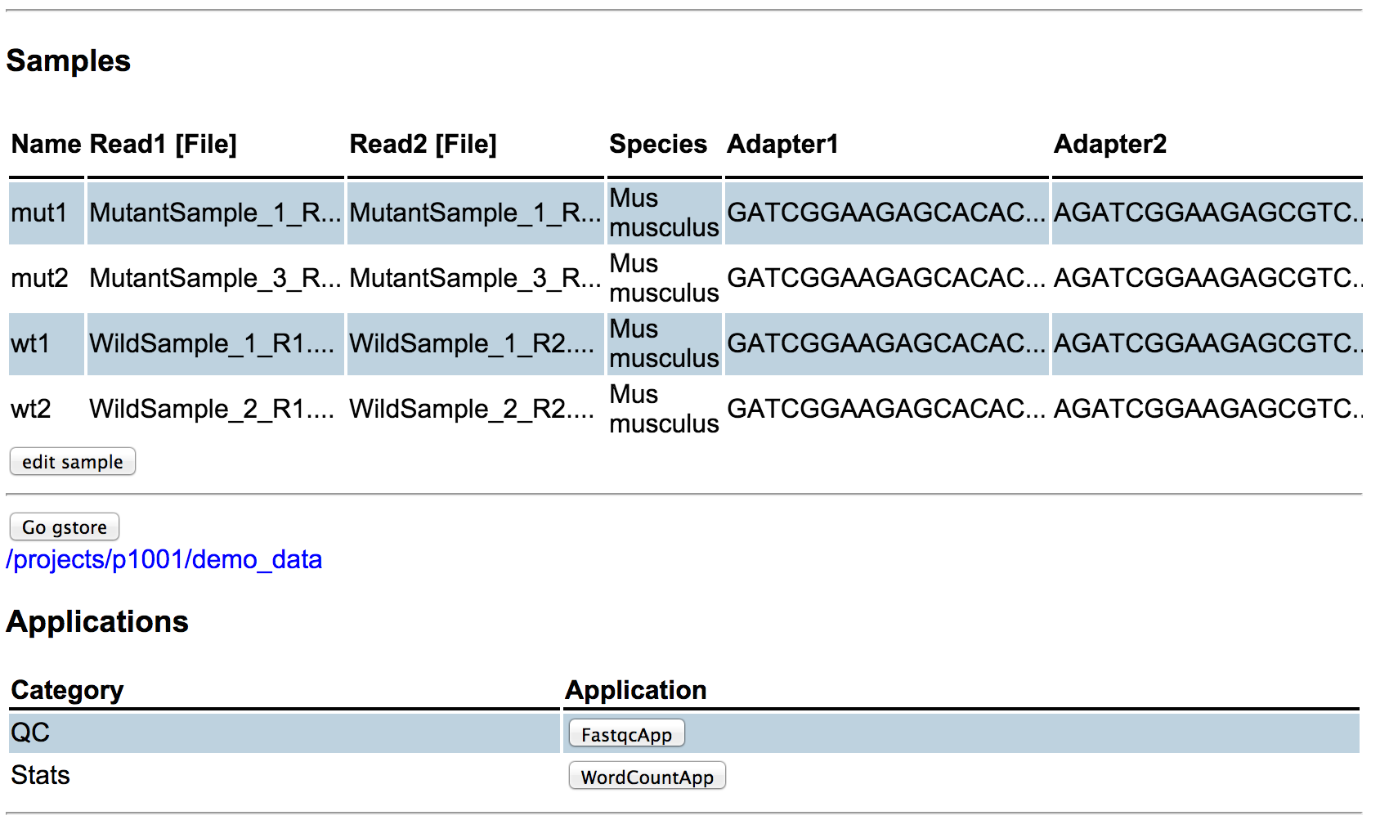
New Application Import

Slide 54
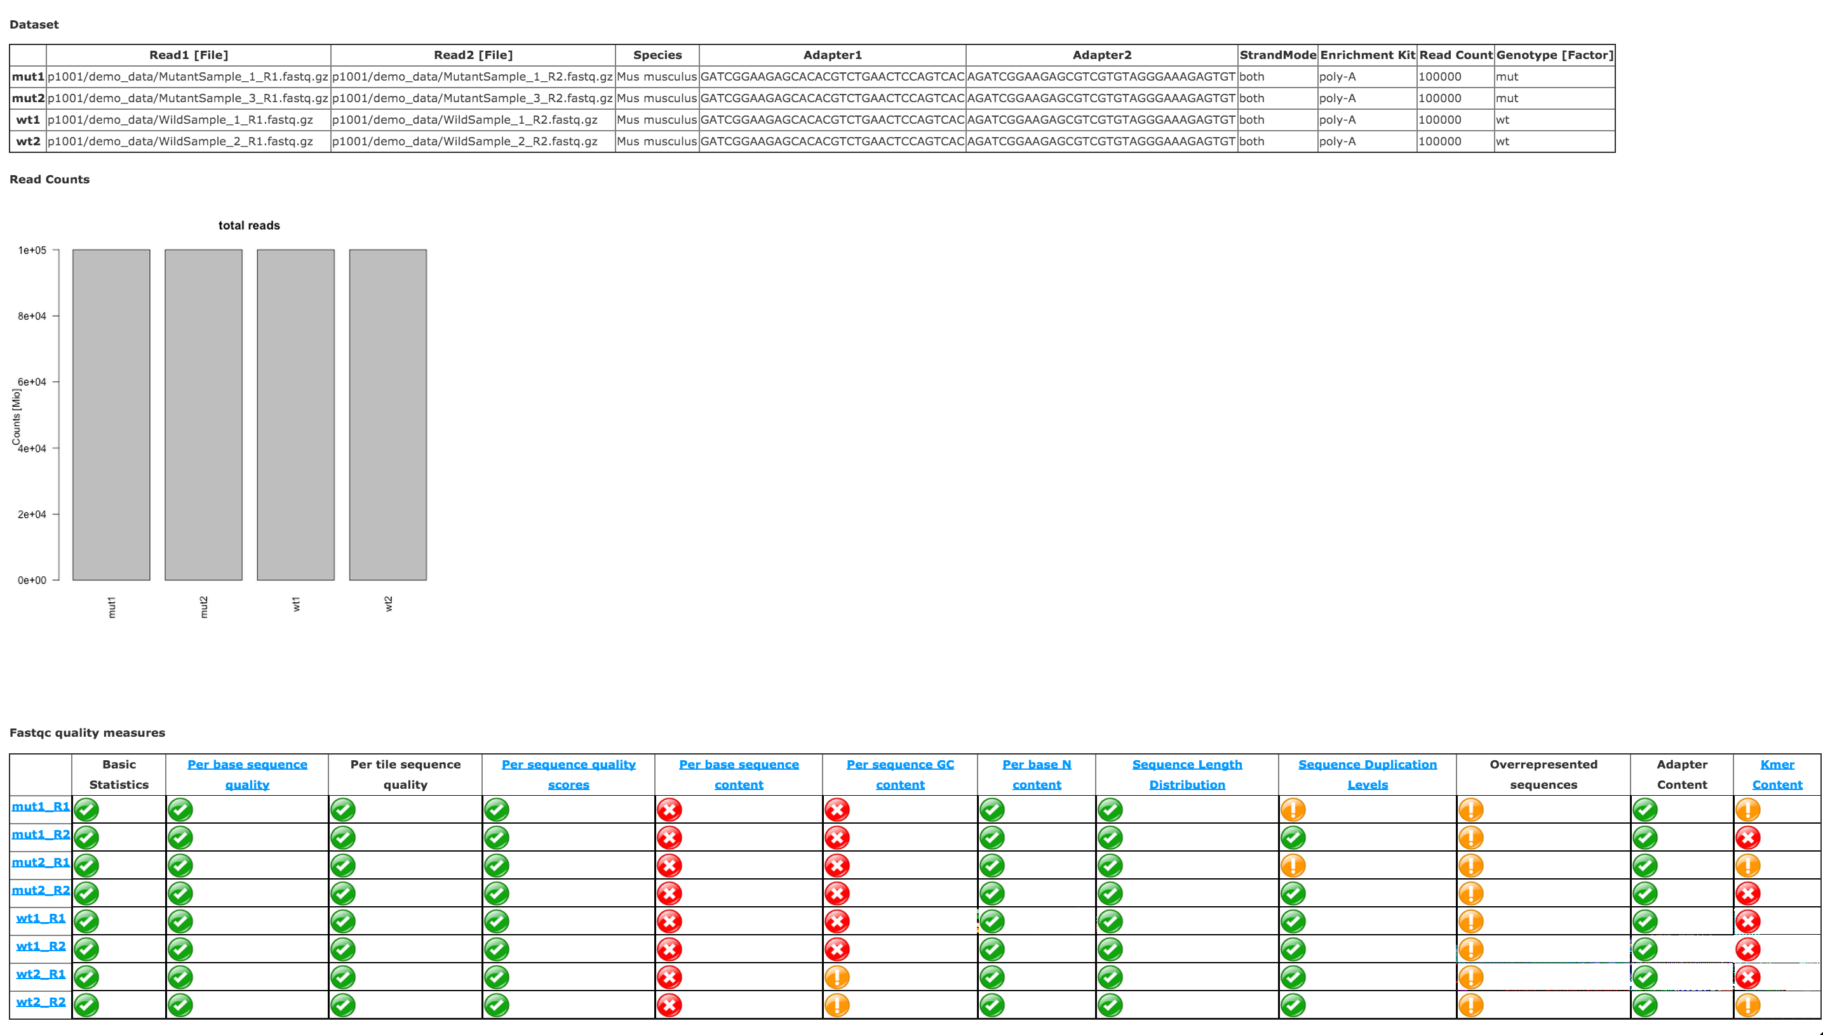
FastQC result

Slide 55
A Case Study –RNAseq DEG analysis-
RNAseq Analysis
Quality Control
FastQC
Mapping
STAR
Counting
HTSeq
Differential Gene Expression
EdgeR

Slide 56
A Case Study

Slide 57
Summary
S
A
S
H
I
M
I
Shell script auto-generating
Application Framework
Support all languages
Help bio-logist/-informatician
Implemented on Ruby
Meta-Information DataSet
Interface: GUI / CLI
Notes:
I would like to demonstrate how to cook NGS raw data on Sushi

Slide 58
Thank you for your attention!!
http://fgcz-sushi.uzh.ch

Slide 59
Appendix

Slide 60
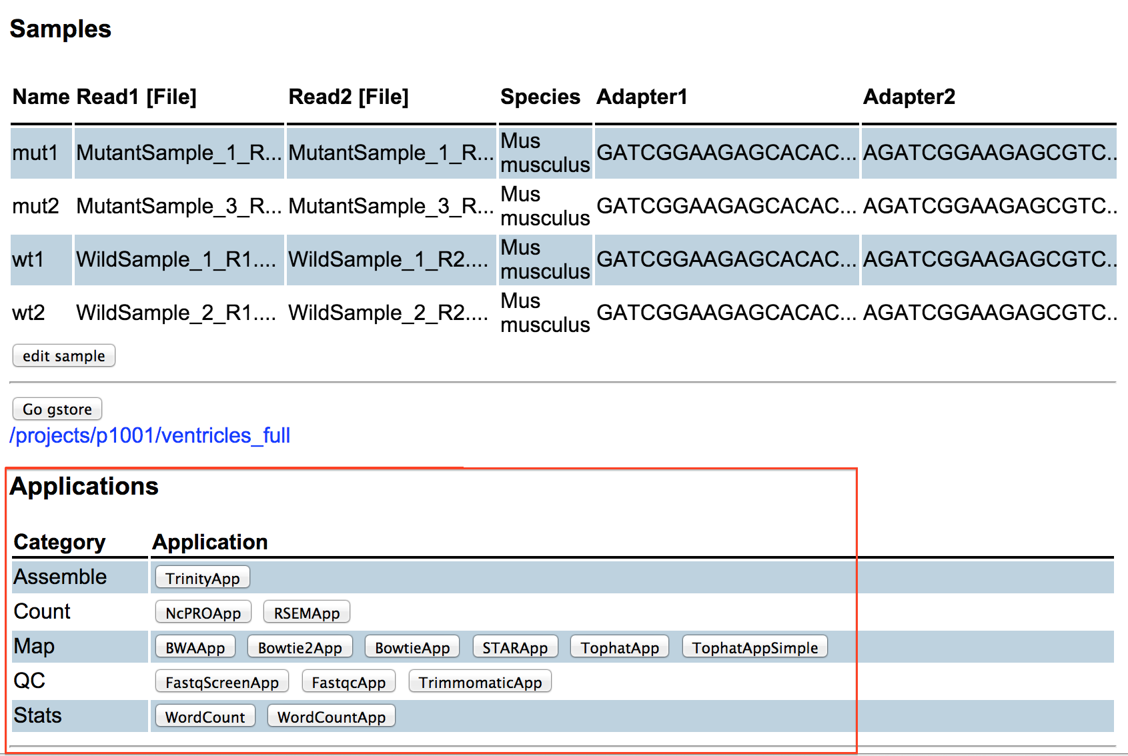
Sushi Run Style
GUI
CLI

Slide 61
Application Mode
SAMPLE mode
Job per Sample, e.g. Tophat
DATASET mode
Job per DataSet, e.g. FastQC

Slide 62
Import New Application
2 ways: prepare
Shell script
Ruby script
Save it in Sushi repository
lib directory
No reboot
Test on CLI
$ sushi_fabric --class WordCountApp --dataset_id 1 –run
Test on GUI

Slide 63
How to add a new application
Inherit SushiApp class
Write Ruby code
Template Method Design Pattern
Possible to tune-up details
Delegate to SushiWrap class
Write Shell script
Ruby Metaprogramming
Quick import

Slide 64
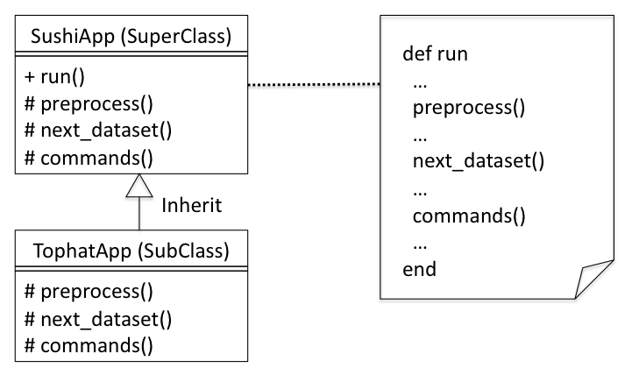
Template Method Pattern
Write Ruby code directly

Slide 65
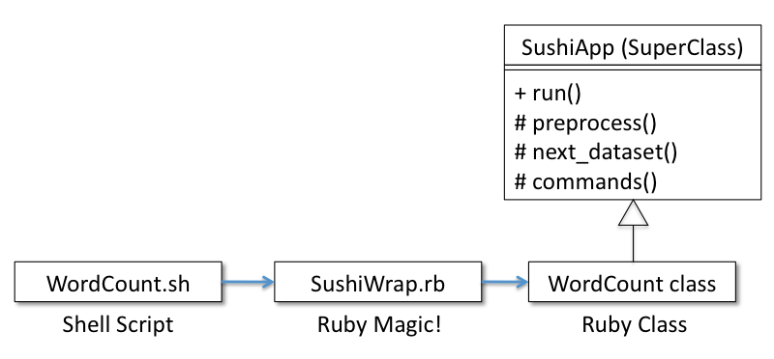
Meta-programming
Ruby code auto generation
from shell script code

Slide 66
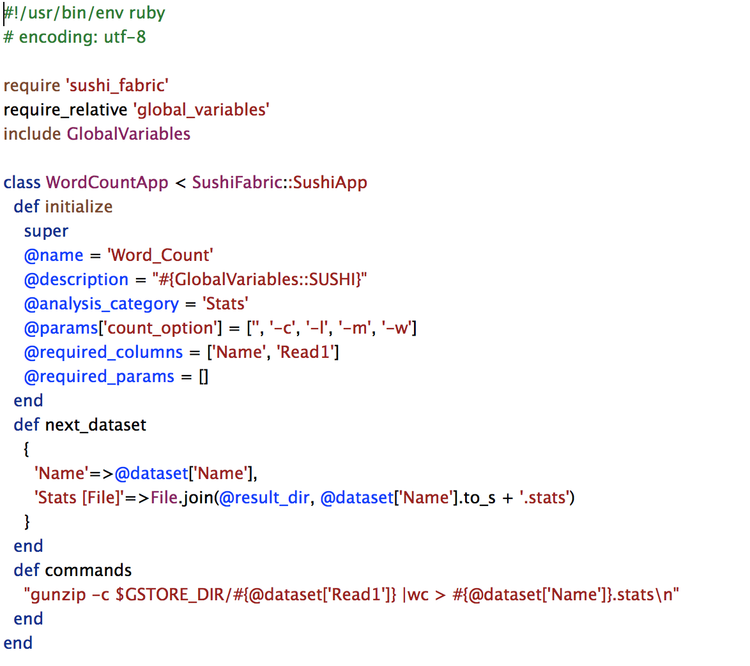
A Sushi App – WordCountApp.rb

Slide 67
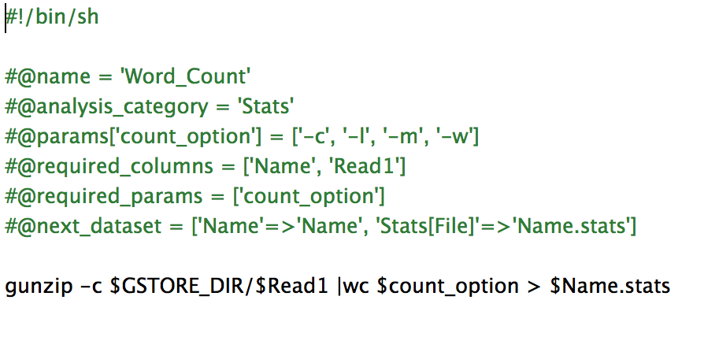
A Sushi App – WordCount.sh

Slide 68
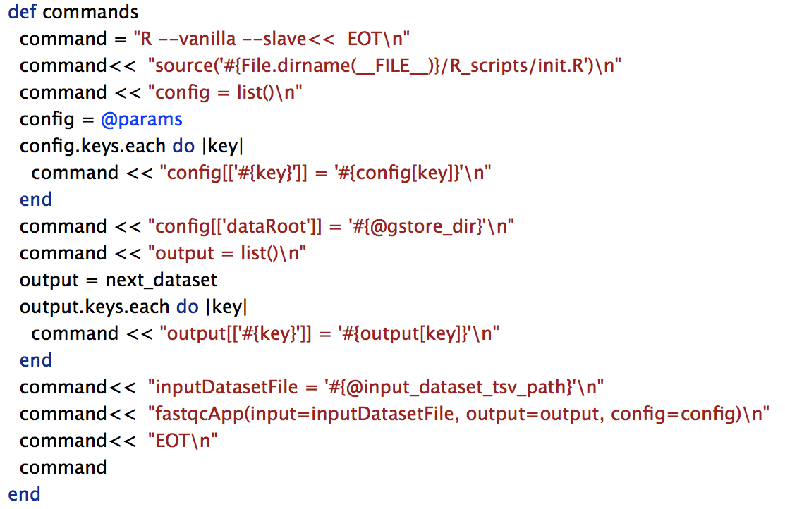
The R Sushi Apps – FastqcApp.rb

Slide 69
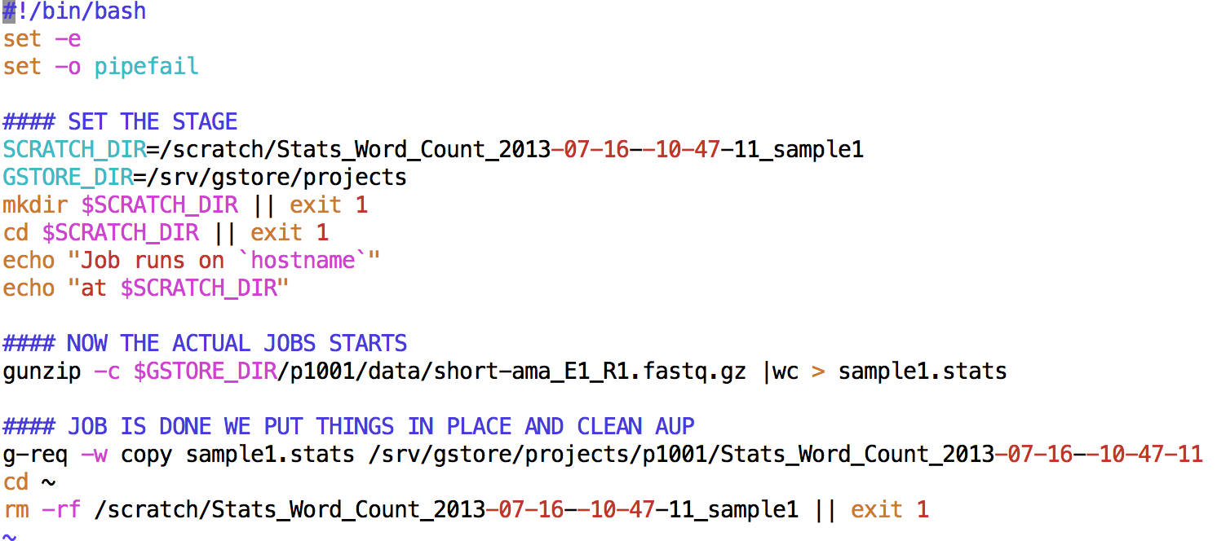
Structure of a Job Script
Generated by Sushi
Generated
by App
Generated by Sushi

Slide 70
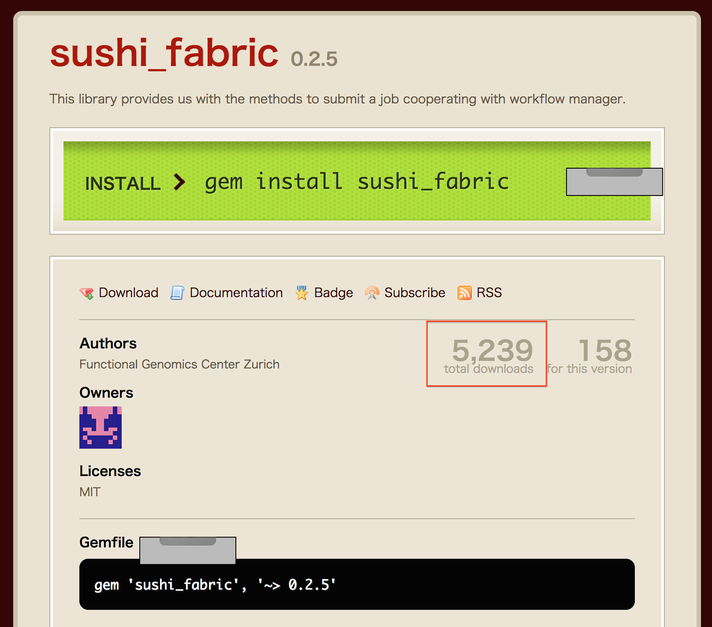
Sushi gem
https://rubygems.org/gems/sushi_fabric

